Slide 1
When we Lost our Shine
Erica Heline, Meaghan Barrett, & Jacob McFadden

Slide 2
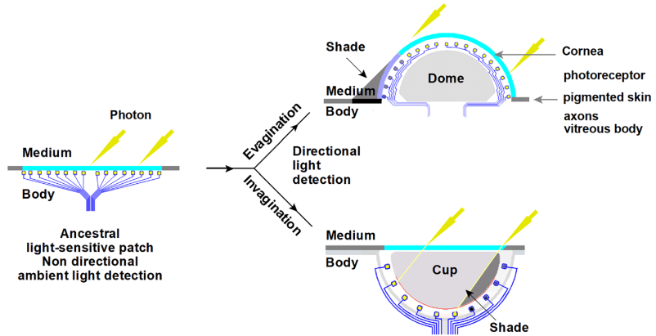
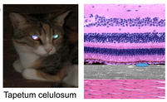
What Are We talking about?
Tapetum lucidum is a reflective layer of tissue behind the retina that reflects light back through the retina to improve night vision.
This creates the reflecting-eye effect that allows us to see them in the dark...and for them to see us.
Retina
RPE & CC
Choroid
Diagram of tapetum lucidum cellulosum found in carnivores including lower primates: retina, retinal pigment epithelium (RPE), choriocapillaris (CC), and choroid⁸.
Diagram of a verted and inverted retina¹

Slide 3
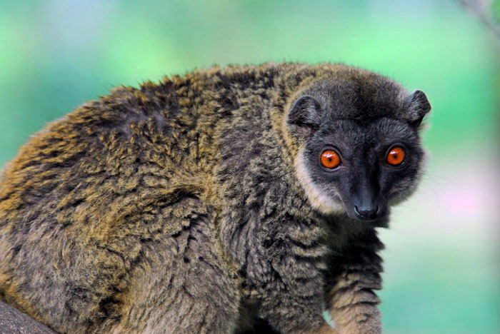
Why do scientists think we lose our lucidum?
Haplorhini became diurnal.
This is backed up by the fact that Eulemurs, diurnal Lemurs have also lost their lucidum⁵.
Selective pressure would require color-rich vision, requiring color vision and high acuity of which the tapetum would be in the way of^{13,17.}

Slide 4
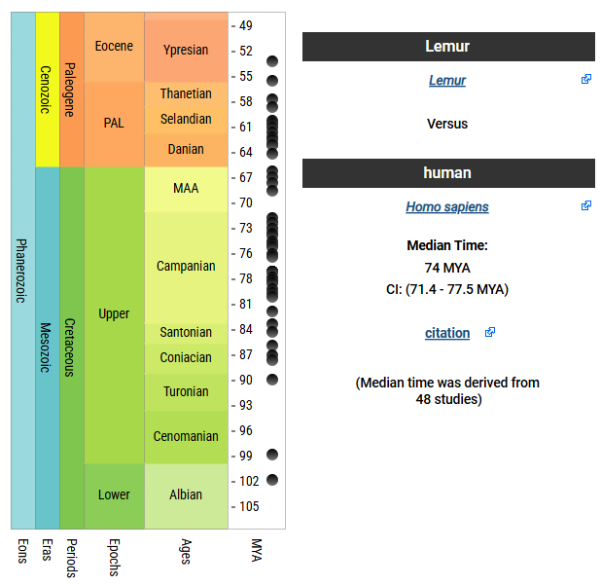
When Did We Lose it?
Time Tree divergence estimated between Homo sapiens (and other members of Haplorhini) and Lemurs (and other members of Strepsirrhini)⁵.

Slide 5
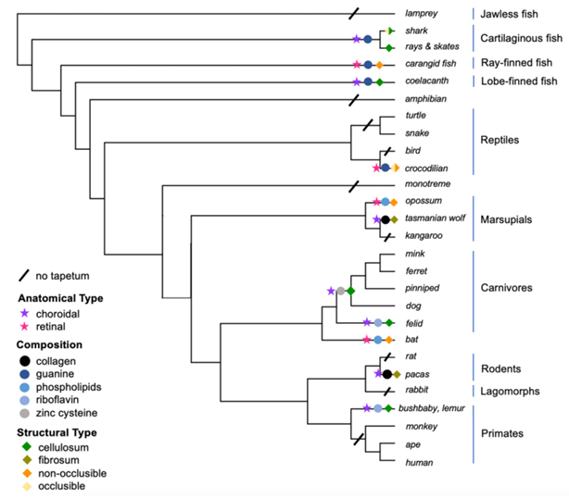
Where Did We Lose it?
Lemurs still have a riboflavin-based tapetum³ that is used to allow them to move in dim environments⁵.
Phylogenetic Tree Showing the presence of tapetum lucidum in various organisms³

Slide 6
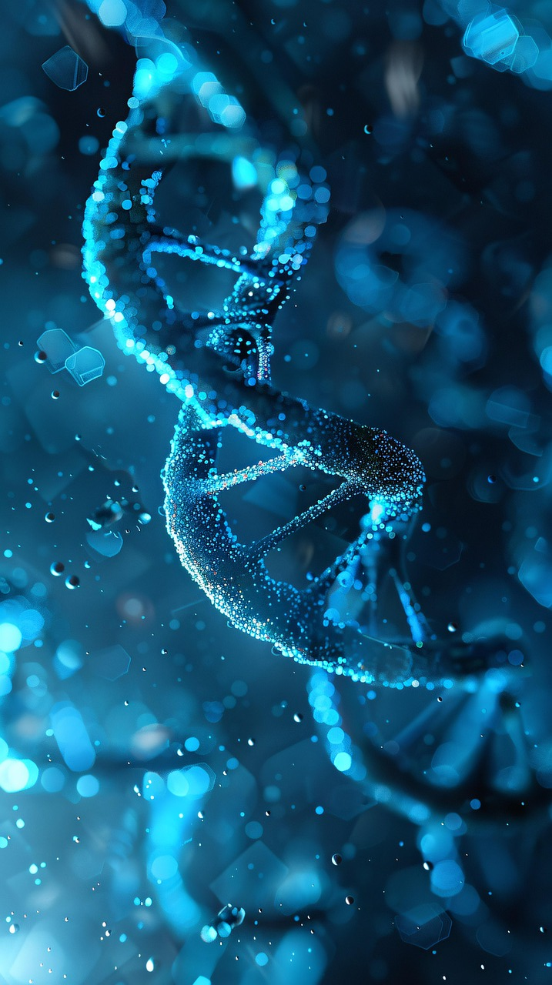
Genes of Interest
G6PD – NADPH reduction^{11,12}.
IRBP – Retinoid transport between photoreceptors and retinal pigment epithelium^{9,10}.
MC1R – Pigment Regulation^{14,15}.
RAG2 – Immune system development^{14,16}.
Mitochondrial – DNA passed matrilineally without recombination^{7,18}.

Slide 7
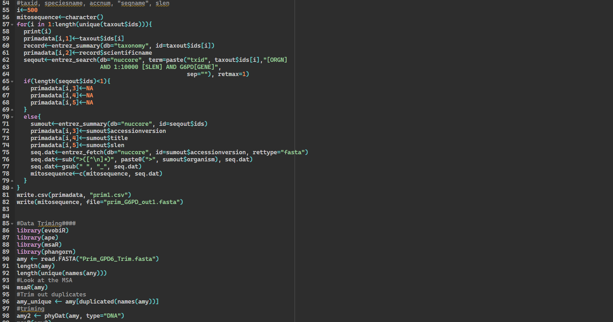
Methodology
Notes:
Methodology: It is how it all came together. From collecting the gene information all the way to the supermatrix and trees.
And this all started in R.

Slide 8
Data Collection
Data Collection
Alignments
For collecting data for each of our genes (G6PD, RAG2, IRBP, MC1R, and Mitochondrial) we used the R program rentrez, , XML, dplyr, httr, and seqinr to collect primate DNA sequence data for each of our genes. Along with collecting DNA sequence data for our outgroup.
The R code we used can be found here: https://github.com/BARRETTMEAG/Lucidum/blob/main/1.%20Datasets/Dataset_template.R
After Collecting our DNA sequence data for each gene, we took those datasets and plugged them into MAFFT. This individually algin each of our data sets.
Notes:
We like so many of you started in R using those systems mentioned above to access NCBI's Genebank to get the DNA for each of our genes. After many hours and after occasional error, and fighting we got our data.
This code is found here
To align the data MAFFT helped us to see if we were on the right track. I created a program in R that made it so that the data was aligned and trimmed regardless of the length.

Slide 9
Trimming & Matrixes
Alignment Trimming
Matrix
To trim each of our alignments we used the R programs ape, msaR, and phangorn. After that was completed, we took that data and ran it through NG Phylogeny. This was done to ensure a correct alignment trimming.
Took our trimmed alignments, plugged it into Liger (https://github.com/andrewbudge/Liger) through the computer terminal and used Python to dictate what to do. Edited the data in R to show the core data (used the programs ape, msaR, and Biostrings).
Then we examined the super matrix in AliView and deleted the taxa that showed little to no data. Reused Liger to only show the taxa that we wanted in AliView.
Notes:
We made sure that the DNA code removed duplicates and trimmed 50% of gaps. Also that each code had it's own spacing.
The first time, I trimmed the Data and tried to manually align this Data in a supermatrix, the supermatrix and the trees were not pretty at all
The second time: I used the tools available to and plugged it into NGPhylogeny.
The results: Some of the data was fine while others keeps getting a message that there was too distant.
After figuring out some of the problem DNA using AliView, cut that Data and get it ready for the supermatrix.
Andrew please stand up and take a twirl around so we can all see ya. It is this man, who introduced us to his program called Liger. This is a computer program that you use in your terminal that allows you to align your fasta files into a supermatrix. It was a miracle.
After liger, I used R again to only show the core region of the supermatrix and retrimmed the code in AliView, which not only allowed me to get the trimmed names of the organisms, but also gave me the trimmed version fasta file.

Slide 10
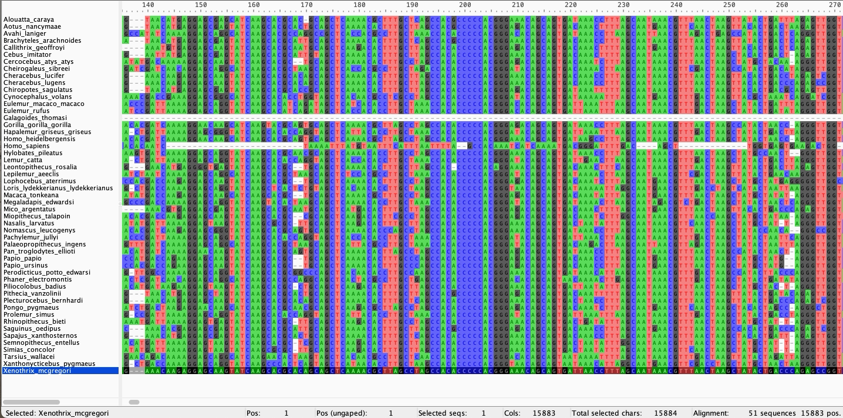
Super Matrix
Notes:
Shown here is our cut down 50 taxa super matrix, This is our old matrix, as you can see homo_sapiens is causing all sorts of problems already.

Slide 11
Bayesian Analysis & Tree Inference
Bayesian Analysis
Designing The Tree
With our matrix in hand, we did a Bayesian Analysis with it using BEAST2. The analysis was done with a chain length of 10 million. After the Bayesian analysis was done we put the results in the program Tracer to determine its ESS score.
Each tree has their own unique requirements.
To create a tree that showed the posterior values, there are many ways to go. With the help of Beauti and Beast and iqtree, the trees were formed.
Figtree allowed for viewing the trees. Selected posterior in both Appearance and node labels, allowed for the coloring of branches. This allowed to see the values and varying of color, depending on the tree.
In many of the trees, homo sapiens branch was longer than others.
Notes:
When using Beuti-Beast for our trees, we followed the steps from Taming of the Beast2. I must say that Beauti is really more of a Beast, especially when it came to the prior portion. After creating the files, we inputted them into Tracer and TreeAnnotator. Our first attempts, were bad, it resulted in Homo_sapiens being out in the left field, now the tree looks night and day different.
Granted every tree is unique, personally, I like iqtree a lot more. Thank you Dr. Hjelmen for teaching us about iqtree.
Jam will explain our results

Slide 12
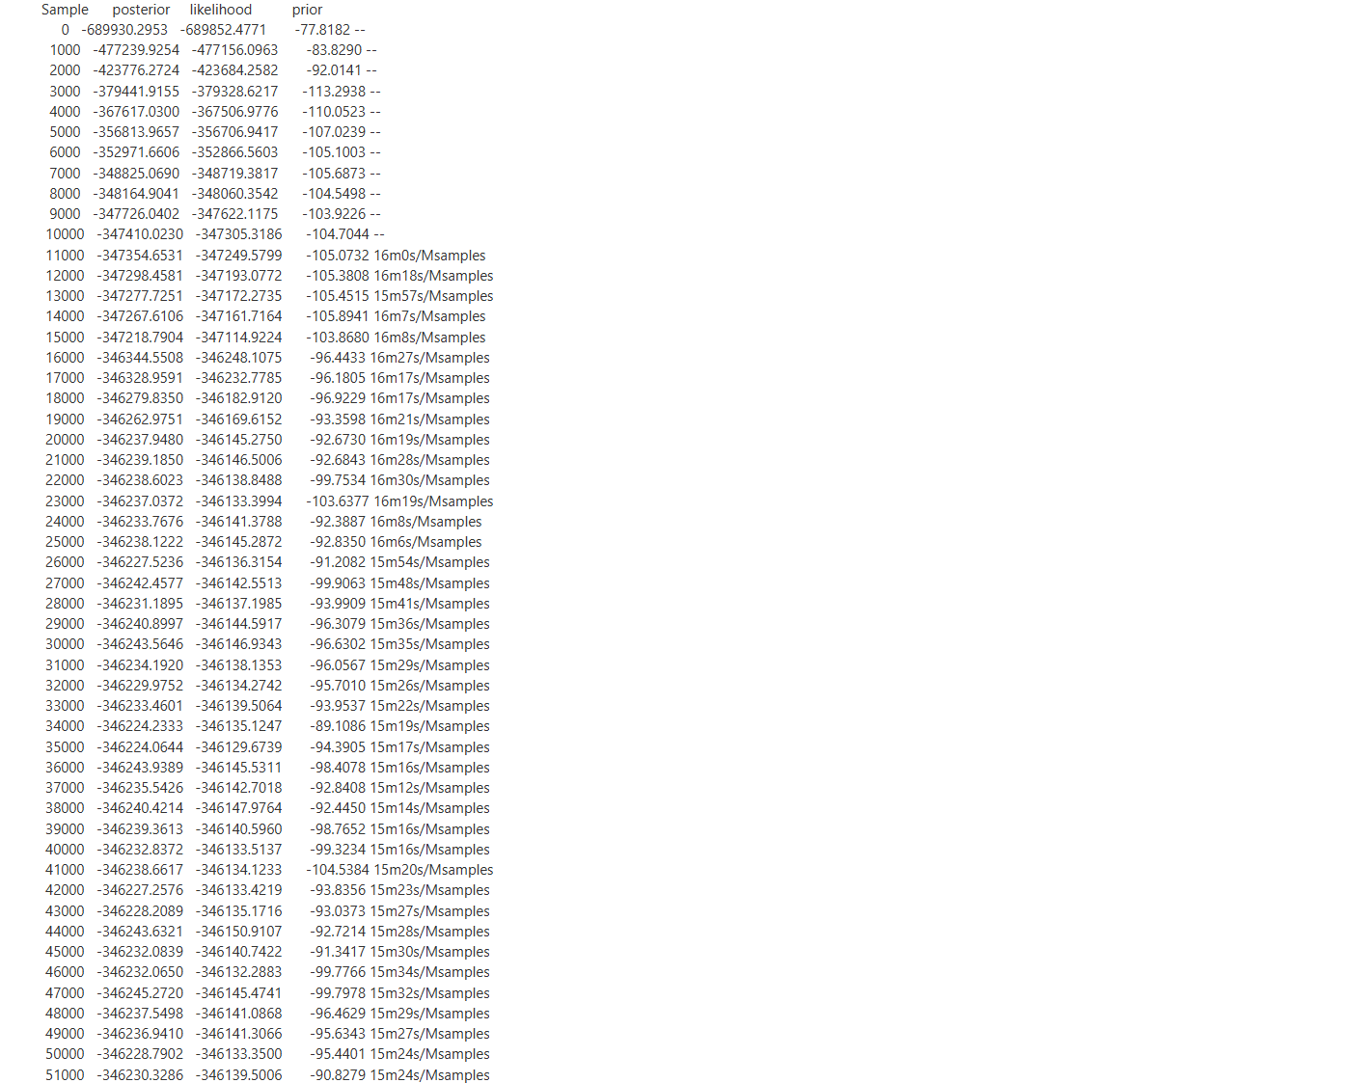
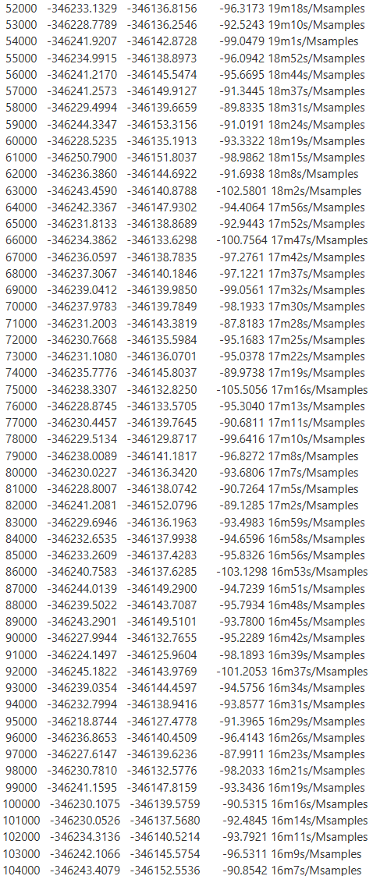
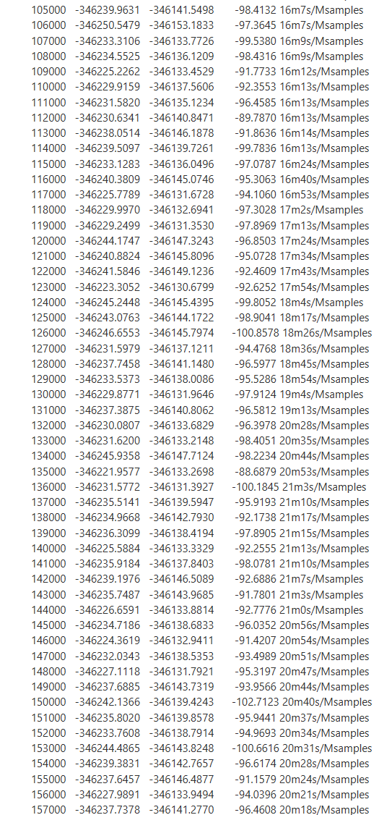
Results

Slide 13
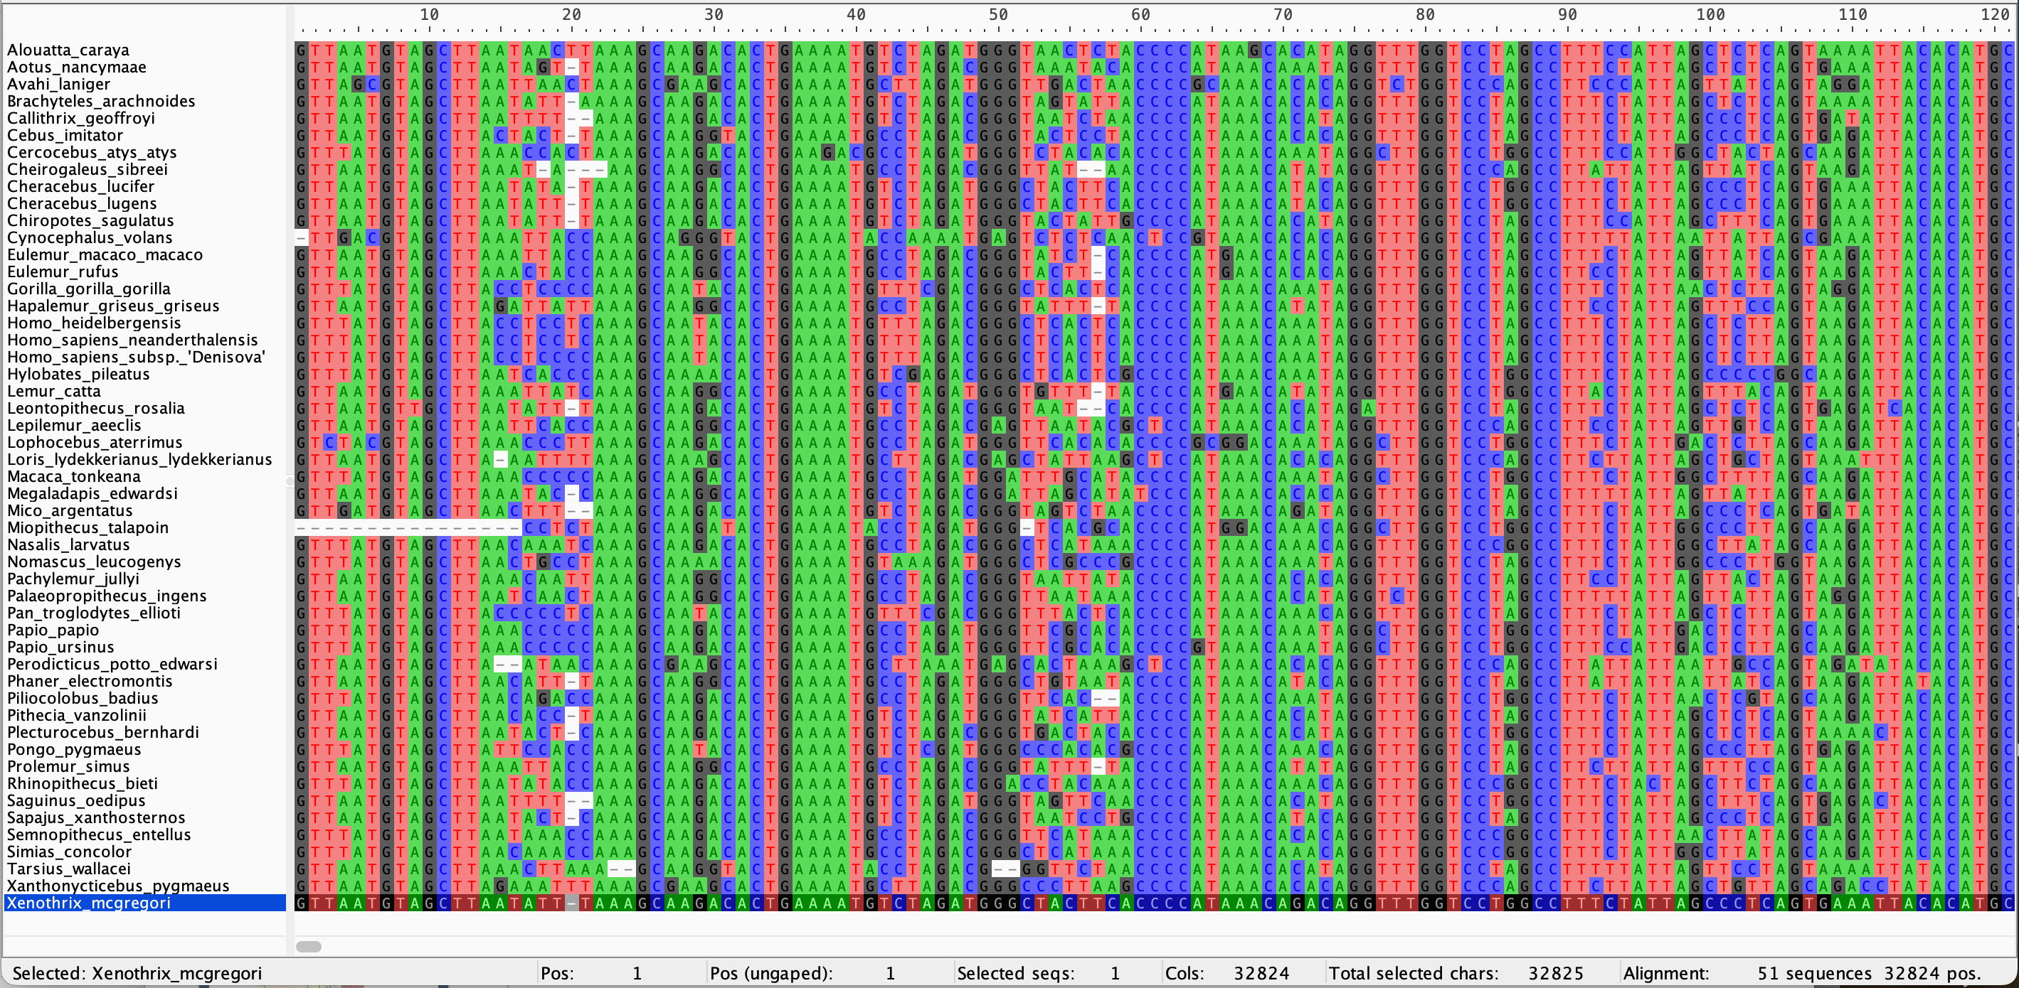
Super Matrix
Notes:
Shown here is our cut down 50 taxa super matrix

Slide 14
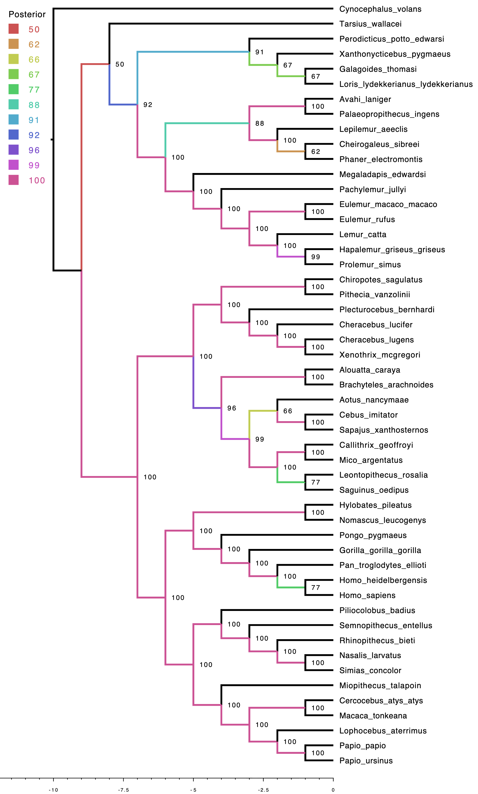
This shows the posterior values of our tree and its validity. As we all know not all trees are created equal.
Notes:
We confirmed that our alignments and supermatrix looked okay with limited gaps and a decent alignment, and yet we got a tree that is nothing like the one we were expecting with Homo sapiens being unrelated to the Homo heidelbergensis and Pan troglodytes in the BL tree.

Slide 15
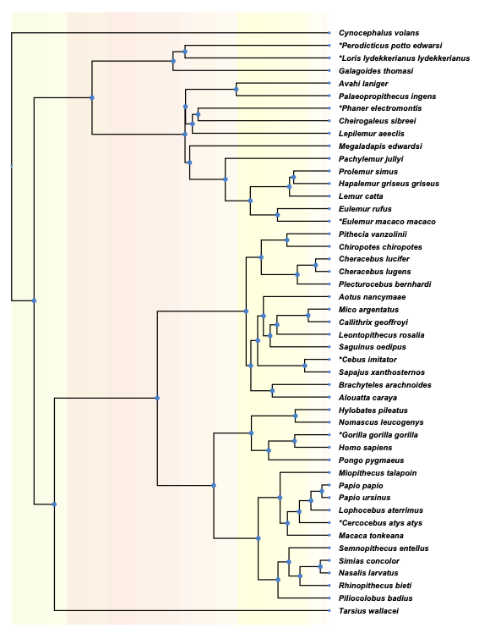
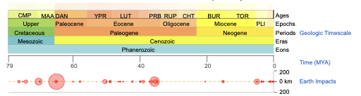
Lucidum
No Lucidum
Unknown
TimeTree
Notes:
This shows roughly about the time that we lost our lucidum, we use TimeTree

Slide 16
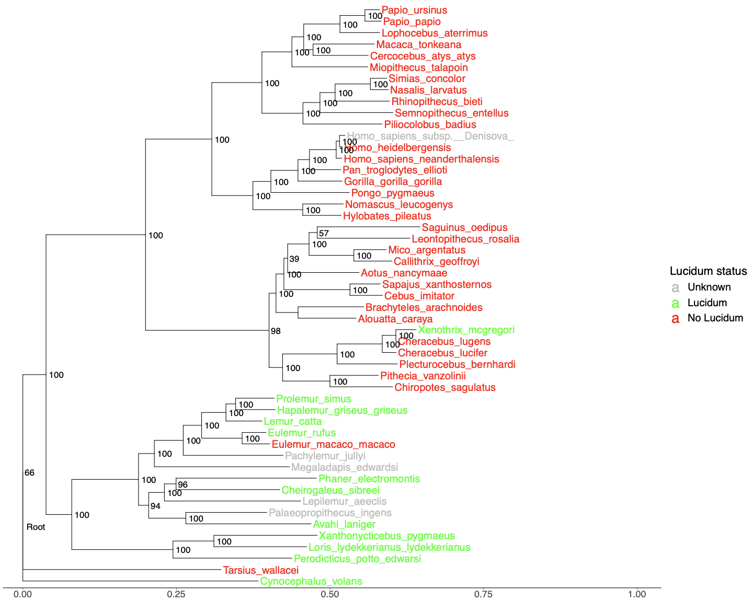
Notes:
Should only see two loses and a gain, Tarsis should be a dry nose, but it is see it with the lemurs. Homo sapiens was causing problems and so we removed it.

Slide 17
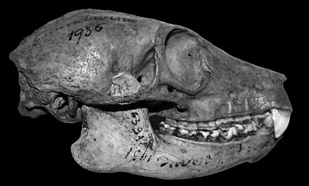
Discussion
From our results we can tell that a split ~75 million years ago was the start of primates losing their lucidum. This split may be when lemurs diverge from other primates. Based on figure 3, where nearly all lemurs have their lucidum, and are on one side of this split 75 mya.
Eulemur macaco macaco mutated to not have a lucidum. Xenothrix mcgregori on the other hand mutated to have a lucidum

Slide 18
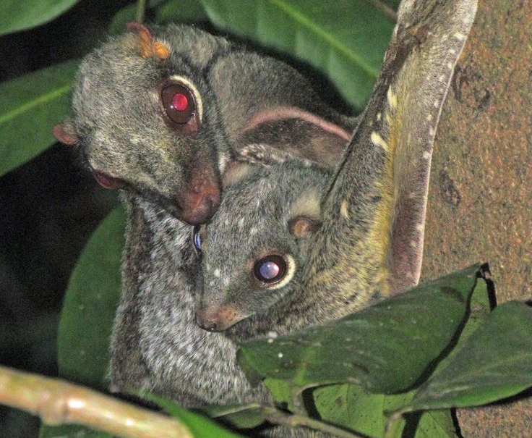
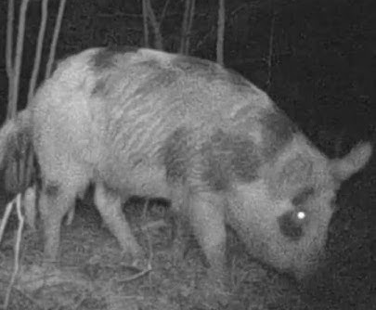
Future Direction
Expand our list of taxa outside of primates.
Such as Dermoptera (flying lemures) and pigs.
Looking at T2T genomes of other primates, which could give more conclusive results.
Try again with sets of genes used in other works to more accurate trees like those in Matsui and Hasegawa's 2012 review¹⁹ before then moving on to genes related to the lucidum and what remains of them in non-lucidum species.
Notes:
Mention that we don’t know the actual gene responsible for the lucidum

Slide 19
References -
1. Oomens, J.M.M. A possible origin of the inverted vertebrate retina revealed by physical modeling. J Biol Phys 50, 327–349 (2024). https://doi.org/10.1007/s10867-024-09662-6
2. Sudhir Kumar, Glen Stecher, Michael Suleski, S. Blair Hedges, TimeTree: A Resource for Timelines, Timetrees, and Divergence Times, Molecular Biology and Evolution, Volume 34, Issue 7, July 2017, Pages 1812–1819, https://doi.org/10.1093/molbev/msx116
3. Vee, S., G. Barclay, and N.H. Lents. 2022. The glow of the night: The tapetum lucidum as a co-adaptation for the inverted retina. BioEssays 44(10): e2200003
4. Newman, B. A., & Hammond, B. R. (2025). Potential Spectral Tuning of the Tapetum Lucidum in a Broadly Distributed Ungulate. Journal of Experimental Zoology Part A: Ecological and Integrative Physiology, 343(8), 905-910. https://doi.org/10.1002/jez.70007
5. Schapker, N. M. (2025). Primate assessment of risk during arboreal locomotion (Doctoral dissertation, Kent State University)
6. Schwab, Ivan R et al. “Evolution of the tapetum.” Transactions of the American Ophthalmological Society vol. 100 (2002): 187-99; discussion 199-200.
7. Finnegan, N., M. Lima, M. G., & Lynch, J. W. (2025). Mitochondrial DNA for Phylogeny Building: Assessing Individual and Grouped mtGenes as Proxies for the mtGenome in Platyrrhines. American Journal of Primatology, 87(3), e70017. https://doi.org/10.1002/ajp.70017
8. Zueva, L., Zayas-Santiago, A., Rojas, L., Sanabria, P., Alves, J., Tsytsarev, V., & Inyushin, M. (2022). Multilayer subwavelength gratings or sandwiches with periodic structure shape light reflection in the tapetum lucidum of taxonomically diverse vertebrate animals. Journal of Biophotonics, 15(6), e202200002. https://doi.org/10.1002/jbio.202200002
9. Poux, C., & Douzery, J. P. (2004). Primate phylogeny, evolutionary rate variations, and divergence times: A contribution from the nuclear gene IRBP. American Journal of Physical Anthropology, 124(1), 01-16. https://doi.org/10.1002/ajpa.10322
10. Zeng, S., Zhang, T., Madigan, M. C., Fernando, N., Zhou, F., Pierce, M., Chen, Y., Huang, L., Natoli, R., Gillies, M. C., & Zhu, L. (2020). Interphotoreceptor Retinoid-Binding Protein (IRBP) in Retinal Health and Disease. Frontiers in Cellular Neuroscience, 14, 577935. https://doi.org/10.3389/fncel.2020.577935

Slide 20
References (continued) -
11. Von Dornum, M., & Ruvolo, M. (1999). Phylogenetic Relationships of the New World Monkeys (Primates, Platyrrhini) Based on Nuclear G6PD DNA Sequences. Molecular Phylogenetics and Evolution, 11(3), 459-476. https://doi.org/10.1006/mpev.1998.0582
12. Tang, B. L. (2019). Neuroprotection by glucose-6-phosphate dehydrogenase and the pentose phosphate pathway. Journal of Cellular Biochemistry, 120(9), 14285-14295. https://doi.org/10.1002/jcb.29004
13. Ollivier, F. J., Samuelson, D. A., Brooks, D. E., Lewis, P. A., Kallberg, M. E., & Komáromy, A. M. (2004). Comparative morphology of the tapetum lucidum (among selected species). Veterinary Ophthalmology, 7(1), 11-22. https://doi.org/10.1111/j.1463-5224.2004.00318.x
14. Munds, R. A., Titus, C. L., Eggert, L. S., & Blomquist, G. E. (2018). Using a multi-gene approach to infer the complicated phylogeny and evolutionary history of lorises (Order Primates: Family Lorisidae). Molecular Phylogenetics and Evolution, 127, 556-567. https://doi.org/10.1016/j.ympev.2018.05.025
15. Wolf Horrell, E. M., Boulanger, M. C., & A., J. (2016). Melanocortin 1 Receptor: Structure, Function, and Regulation. Frontiers in Genetics, 7, 187214. https://doi.org/10.3389/fgene.2016.00095
16. Chen, X., Yao, L., Li, W., Ma, S., Yuan, X., Yang, Y., Yuan, Y., Liu, Y., Liu, L., Wang, H., Gellert, M., & Yang, W. (2025). How RAG1/2 evolved from ancestral transposases to initiate V(D)J recombination without transposition. Proceedings of the National Academy of Sciences, 122(31), e2512362122. https://doi.org/10.1073/pnas.2512362122
Reviews -
17. Regan B. C., Julliot C., Simmen B., Viénot F., Charles–Dominique P. and Mollon J. D. 2001 Fruits, foliage and the evolution of primate colour visionPhil. Trans. R. Soc. Lond. B356229–283 http://doi.org/10.1098/rstb.2000.0773
18. Ferreira, T., & Rodriguez, S. (2024). Mitochondrial DNA: Inherent Complexities Relevant to Genetic Analyses. Genes, 15(5), 617. https://doi.org/10.3390/genes15050617
19. Matsui, A., Hasegawa, M. (2012). Molecular Phylogeny and Evolution in Primates. In: Hirai, H., Imai, H., Go, Y. (eds) Post-Genome Biology of Primates. Primatology Monographs. Springer, Tokyo. https://doi.org/10.1007/978-4-431-54011-3_16

Slide 21

Special Thanks
Andrew Budge for helping with the super matrix and directing us to his program Liger (https://github.com/andrewbudge/Liger).
Dr. Odgen & Dr. Hjelmen for their guidance.

Slide 22
Ask Us Questions

